Slide 1
MyTopling: MySQL on ToplingDB
How do we build the Next Generation Cloud Native Database
Topling Inc.
Lei Peng
2022-07-28

Slide 2
What is Cloud Native Database
The Ideal
MyTopling
Serverless(DBaaS)
Pay on Demand
Elastic Scaling
Infinite Scaling
OPS & Monitoring
MySQL Protocol
Both Computation & Storage on Demand
Both Computation & Storage Elastic
Tens of thousands CPU + PB Storage
Intelligent, SQL & Engine level Monitoring

Slide 3
Parallel Patterns: Data & Task decomposition
Data decomposition
Task decomposition
Decompose data into parts
Each part is on an EU*
Suitable scenarios
less communication between EUs
same computation on different EU
Typical example
Share Nothing(unified computation & storage)
Decompose task into functions
Each functions is on an EU
Suitable scenarios
less relations between functions
different computation on different functions
Typical example
Share Everything (separated computation & storage)
EU*: execution unit

Slide 4
ToplingDB: Frontend/Backend separation
Separated computation & storage
Separated Frontend/Backend computation
AWS Aurora & PolarDB
Shared Storage
Elastic scaling computation
Elastic scaling storage
Based on SCS(separated computation & storage)
Frontend nodes serving users
Backend nodes batch computing
Frontend & Backend scaling indenpendently

Slide 5
MyTopling Cluster Archetecture
Frontend
Elastic Scaling
Read only node
(Follower)
Read write node
(Leader)
MyTopling FrontEnd Cluster
DB Service
DB Service
DB Service
DB Service
DB Service
Elastic, Distributed, Shared Storage
Storage capacity
Elastic Scaling
Backend
Elastic
Scaling
Compact Worker Cluster
Notes:
常规工况下后台计算占比 80% 以上，数据导入过程中后台计算甚至占 95% 以上

Slide 6
MyTopling Cloud Archetecture
Each DB Service Instance
Is a FrontEnd Cluster
DB Service
Instance 1
DB Service
Instance 2
DB Service
Instance 3
DB Service
Instance 4
DB Service
Instance 5
Computation
Storage Separation
Front
Back separation
Infinite Shared Storage 1
Infinite Shared Storage 2
Infinite Shared Storage 3
Infinite Shared Storage 4
Infinite Shared Storage 5
Task Decomposition
Compact Worker Cluster
Sharing Economy: Peak-load shifting, time division multiplexing
Shared by multiple users
Background computation: Utilize idle cheap resource
(EX: AWS Hot spot instance)
Scalable to tens of thousands CPU cores
Data Decomposition
Notes:
云原生部署，每个DB实例，都对应一个共享存储，所有DB实例共享同一个弹性计算集群，这样，来自多个DB实例的流量在计算集群中就可以平峰错谷，提升资源利用率，与此同时，计算集群的结点是无状态的，从而可以使用云厂商的“空闲算力”，“空闲算力”非常便宜，这就进一步降低了成本。

Slide 7
Topling Product Family Architecture
Users
MyTopling
(MySQL)
Todis
(Redis)
Tomongo
(MongoDB)
Other Databases
Human Design
Dynamic Plugin
Online Inspecting
ToplingDB Storage Engine
Topling Core Tech
Topling Parallel Transaction Engine
Topling Searchable in Memory Compression
Topling Elastic Computing
On Shared Storage
Notes:
技术架构上，从用户需求出发，是MySQL，Redis这样的绝对主流，而不管是MySQL还是Redis，他们都可以有不同的实现，同时，RocksDB作为存储引擎界的事实标准，在开源社区已经有了对MySQL，Redis的适配。
我们的ToplingDB是RocksDB的一个超集，所以我们只需要对开源社区的这些适配做一些修改，就得到了我们的产品。然后，作为我们的产品，左边的人性化，是用户肉眼可见的，可以身临其境体验到的，加上右边用户肉眼不可见的压缩算法，以及弹性伸缩，一起为用户创造价值。

Slide 8

MyTopling & ToplingDB Ecosystem
MyTopling SQL Layer
Ecosystem compatibility
Topling
SidePlugin
RocksDB API
Human design & Inspection
MyTopling
SidePlugins
Compact Filter
Metrics Exporter
UserKeyCoder
WebView
WebView For
SidePlugins
(DB|CF)Options
LSM Tree Stats
All Plugin Stats
Metrics Exporter
Topling Builtin
SidePlugins
RocksDB
Topling
Distributed
Compaction
With Topling Enhancements
CSPP MemTable
CSPP Fast SST
Topling
Zip SST
CSPP Txn
Auto Sort SST
Performance/Cost
Notes:
生态兼容，用来降低用户的学习和迁移成本
人性化，用来吸引用户的关注，可以提高运维、追踪、查错的效率

Slide 9
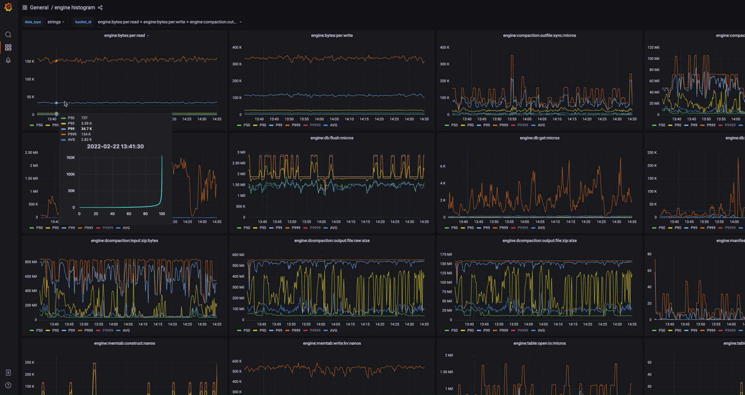
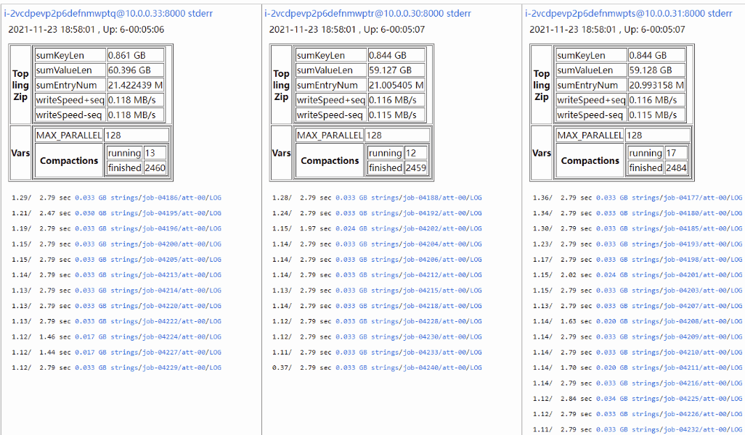
Human designed monitoring and inspecting
Nested Web + Prometheus exporter
The database becomes a transparent fish, we can see its bones, muscles, vessels …
Visualizing the whole histogram in a curve view
Visualizing the distributed compactions’ live activity, more…

Slide 10
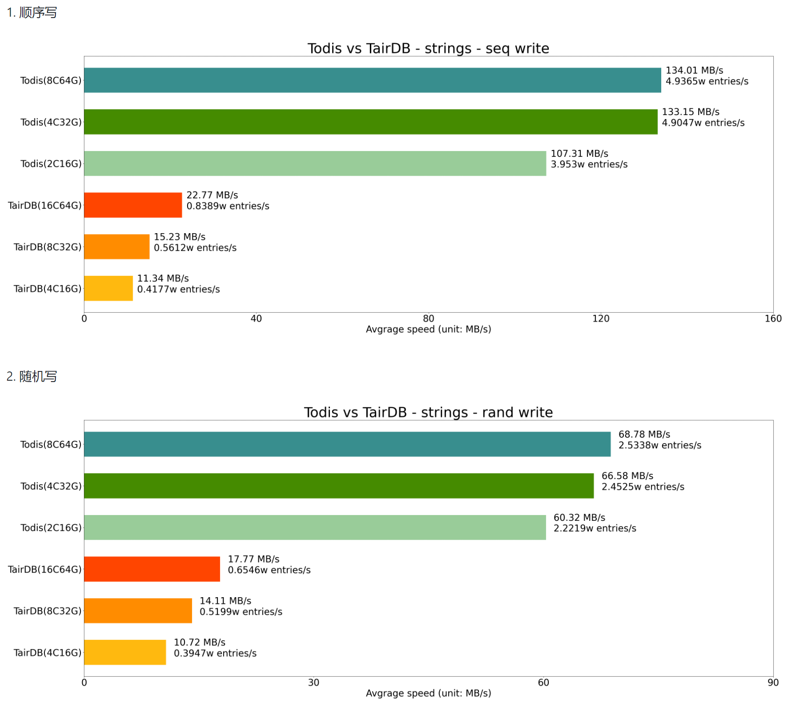
Write is Cost effective
Sequential Write
Data set
Wikipedia
Total size | 109 GB
Number of Entries | 38.5 M
Average Length | 2.8 KB
Write the data set to DB
Random Write
Writing data triggering LSM compaction,
MyTopling(on top of ToplingDB) is benefited by distributed compaction, which offloading the compaction computing to multiple users shared elastic compaction cluster, achieved high continuous writing speed
Benefited by distributed compaction, MyTopling can achieve such performance by smaller server with less cost

Slide 11
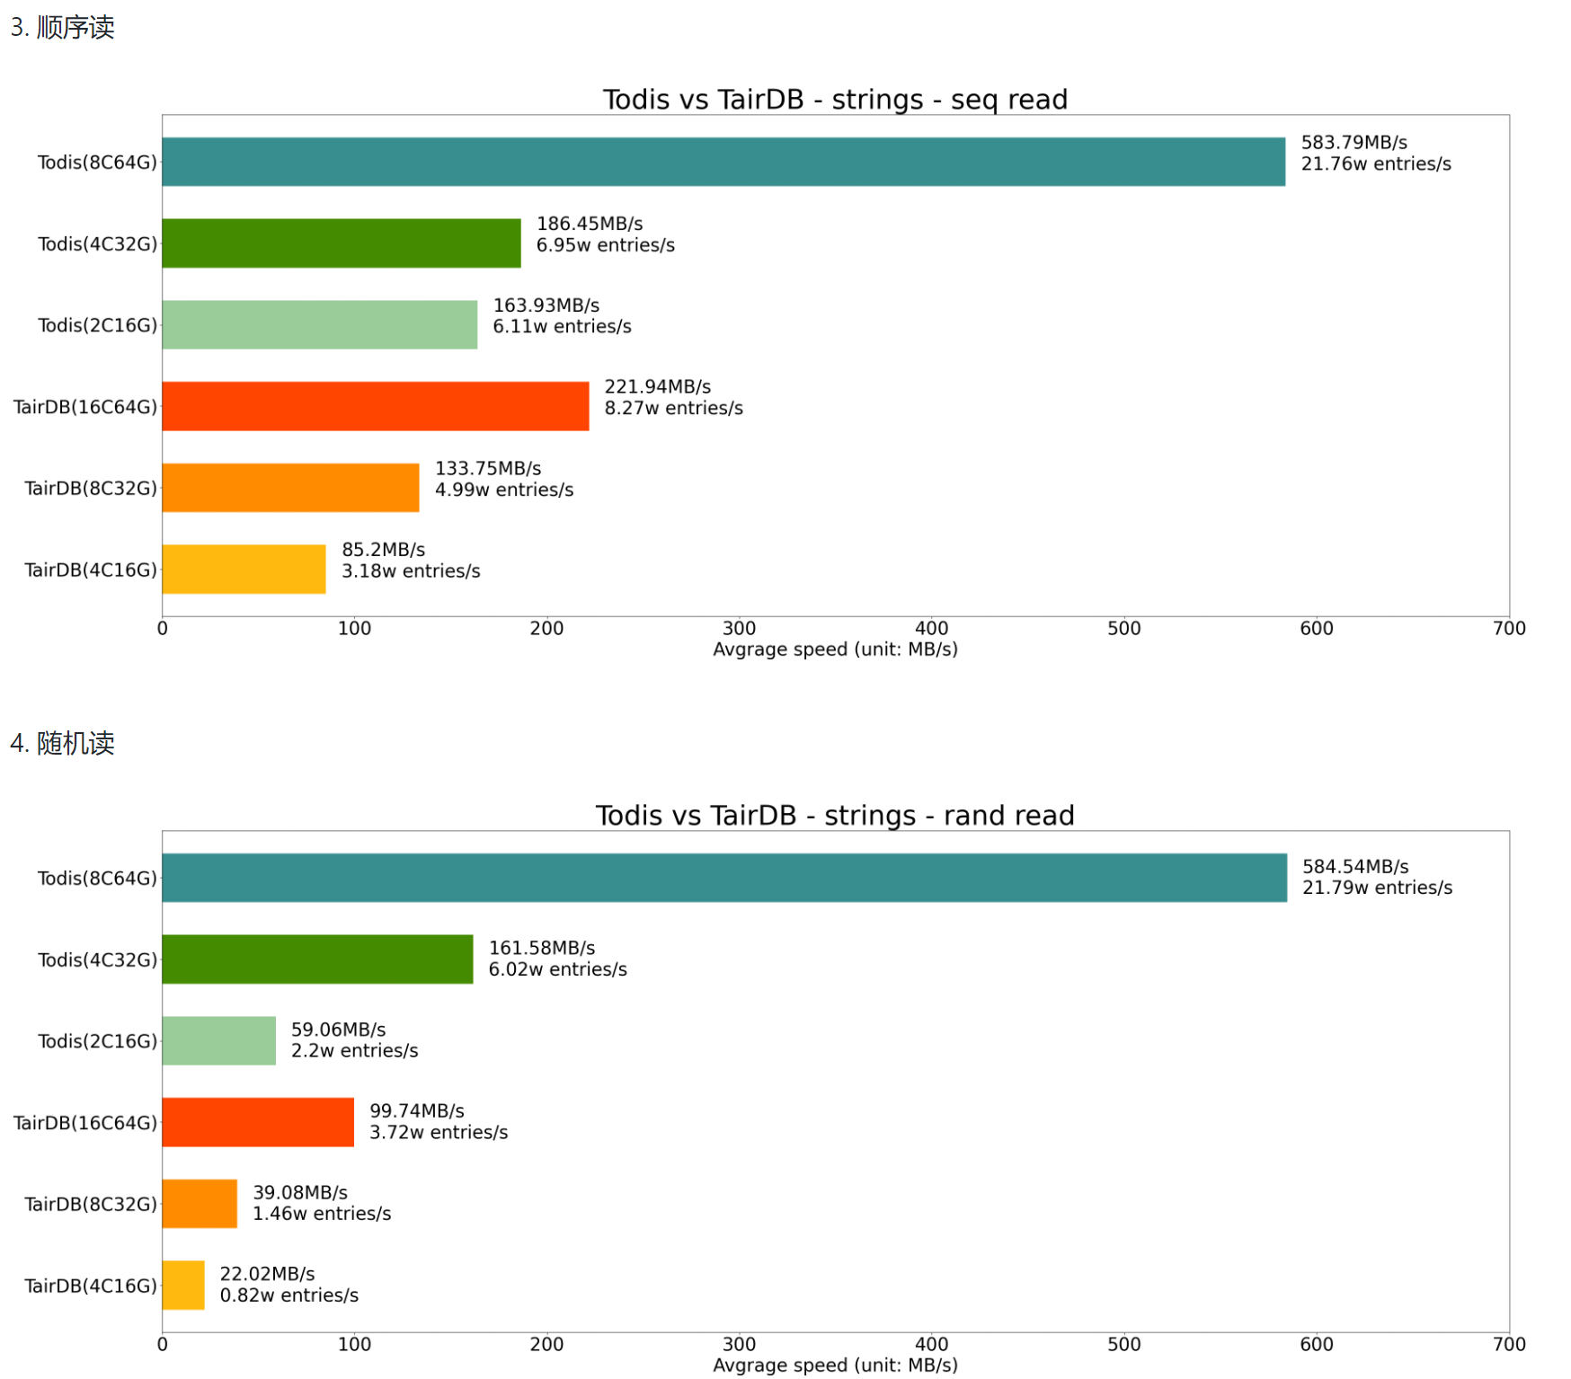
Read is Cost Effective
Sequential Read
Data set
Wikipedia
Total size | 109 GB
Number of Entries | 38.5 M
Average Length | 2.8 KB
Read data from DB by Keys
Full compaction is not run after all data were loaded to DB, to emulate real world workloads
Random Read
Fast read is contributed by point-accessible feature of topling searchable in memory compression algorithms

Slide 12
Wikipedia (109G)
Space is Cost Effective
Random Read, QPS(K op/sec) without RAM limit
Notes:
这里的测试数据是维基百科的数据，总共 109G，3800万条，平均长度 2.8K，我们可以看到，ToplingDB 的压缩率要高得多，在内存限制的情况下，随机读的性能高了 20 倍以上，这就是 ToplingDB 内存压缩算法的优势。
当然，如果不限制内存用量，大家的性能都很好，这个时候，拼的就是成本。

Slide 13
Why new storage engines using LSM Tree
B+ Tree
PK
LSM Tree
Great Write Amplification
Random write
Less Write Amplification
Fast, No Read Amplification
Read
Slow, Read Amplification,
Needs reading each Level
Pages can not be full filled
Storage Space
Data is stored compacted, no waste

Slide 14
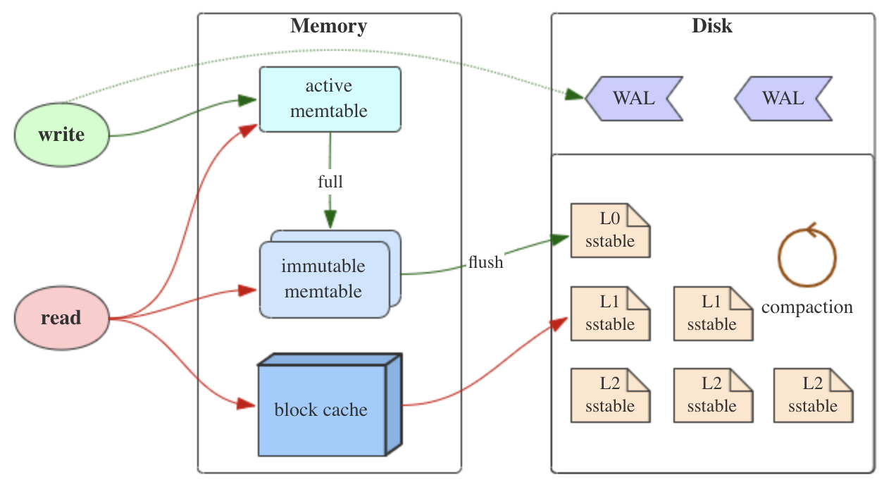
RocksDB Read & Write
SkipList
MemTable
Block
Based
Storing and Searching
BlockBasedTable

Slide 15
ToplingDB Read & Write
CSPP
MemTable
Searchable in memory Data Zip Algorithm
ToplingZipTable
direct search
and read on zipped data

Slide 16
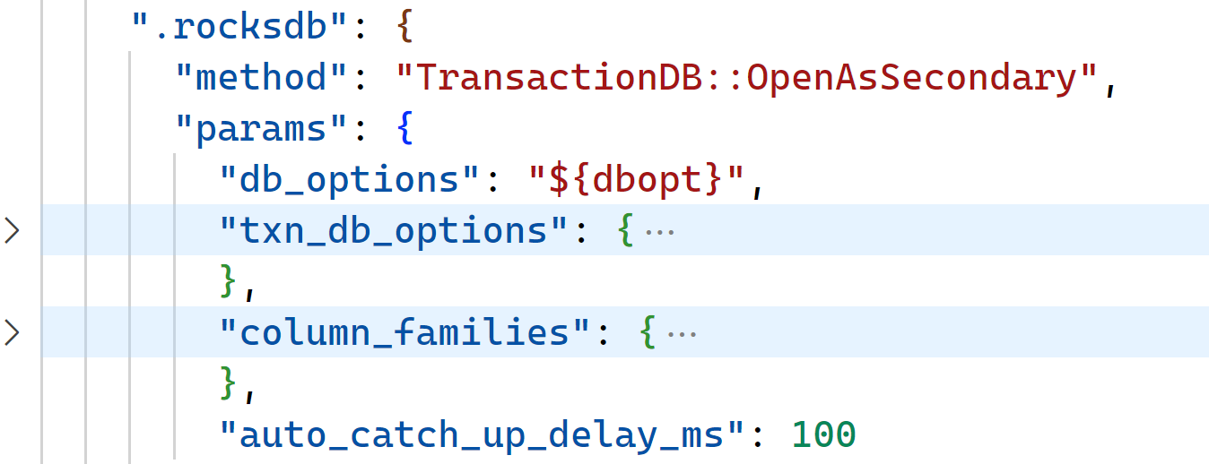
MyTopling: Shared Storage Replica
DDL replica: Using MySQL binlog replica
Primary node: Add param --binlog-ddl-only=ON/OFF
Just keep DDL binlog event, discard other binlog event
DML replica: Using ToplingDB Secondary Instance
Replica node json conf
Any DB using ToplingDB can be configured as shared storage replica by this way

Slide 17
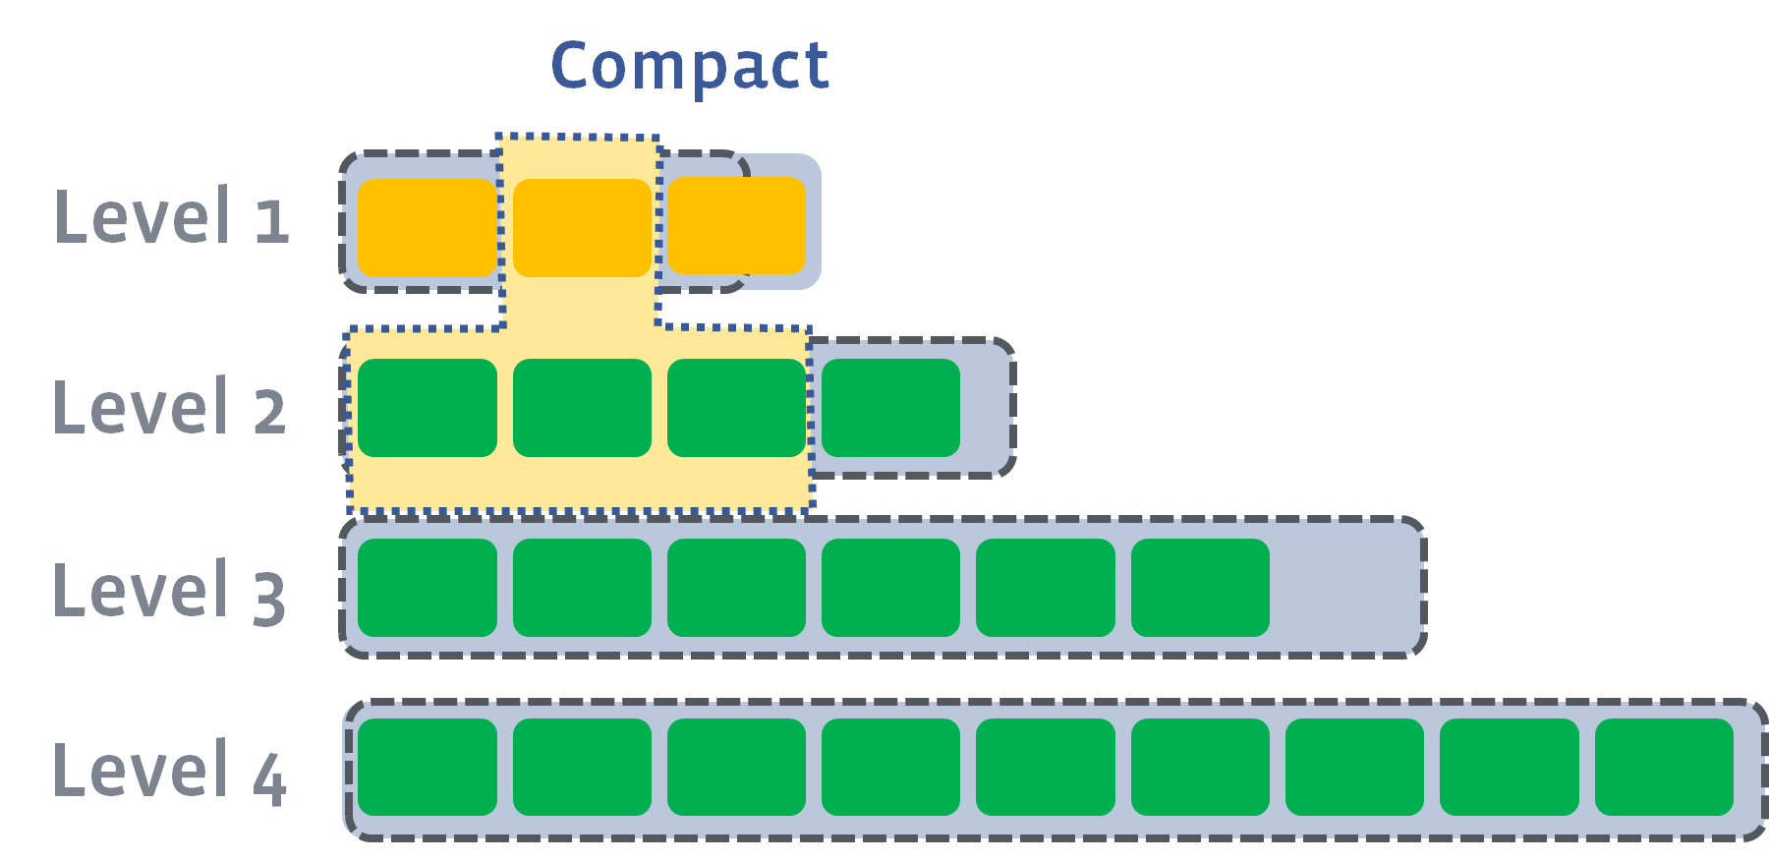
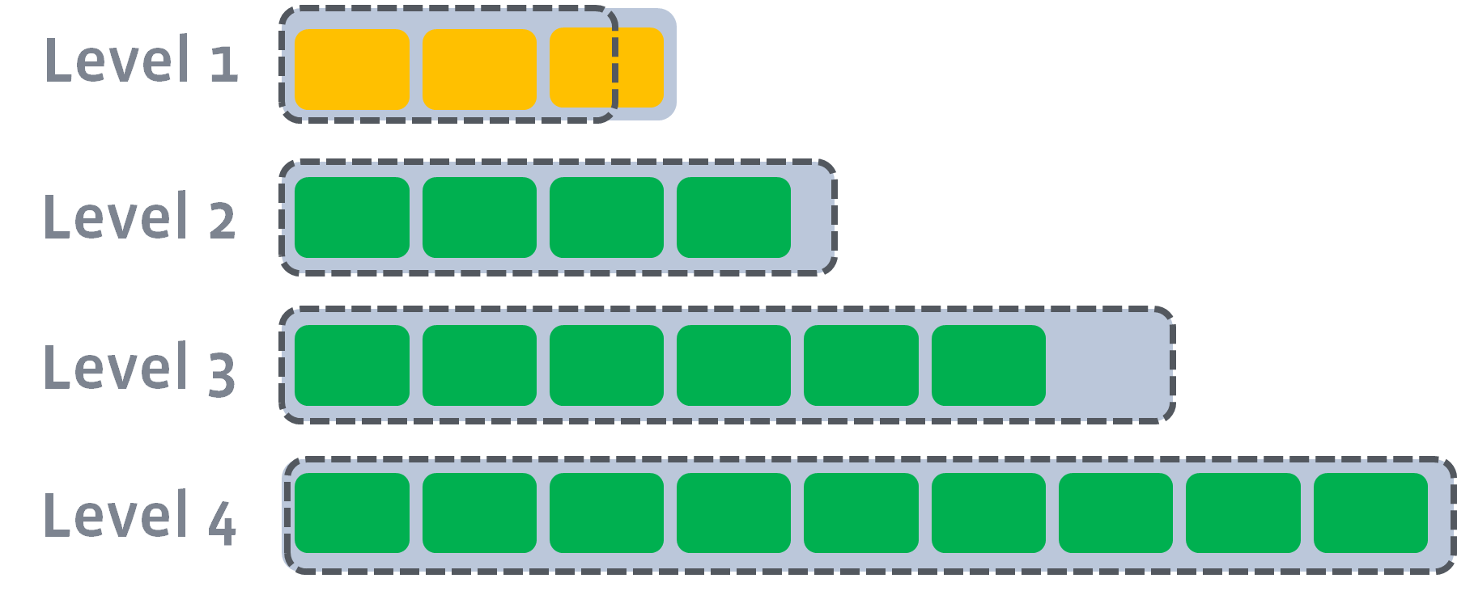
L1 + L2 → L2
L0, Key ranges of files have intersection，L0 + L1 → L1 Compact including all files on L0 and L1
L1 ~ Ln，Key ranges of files have no intersection
L0 & L1 Compactions are running on DB(frontend) node
L2 ~ Ln compactions are running on compaction worker cluster(backend)
Data cap of each level
Grows exponentially
Key range of each file on Ln-1 covers key ranges of multiple files on Ln

Slide 18
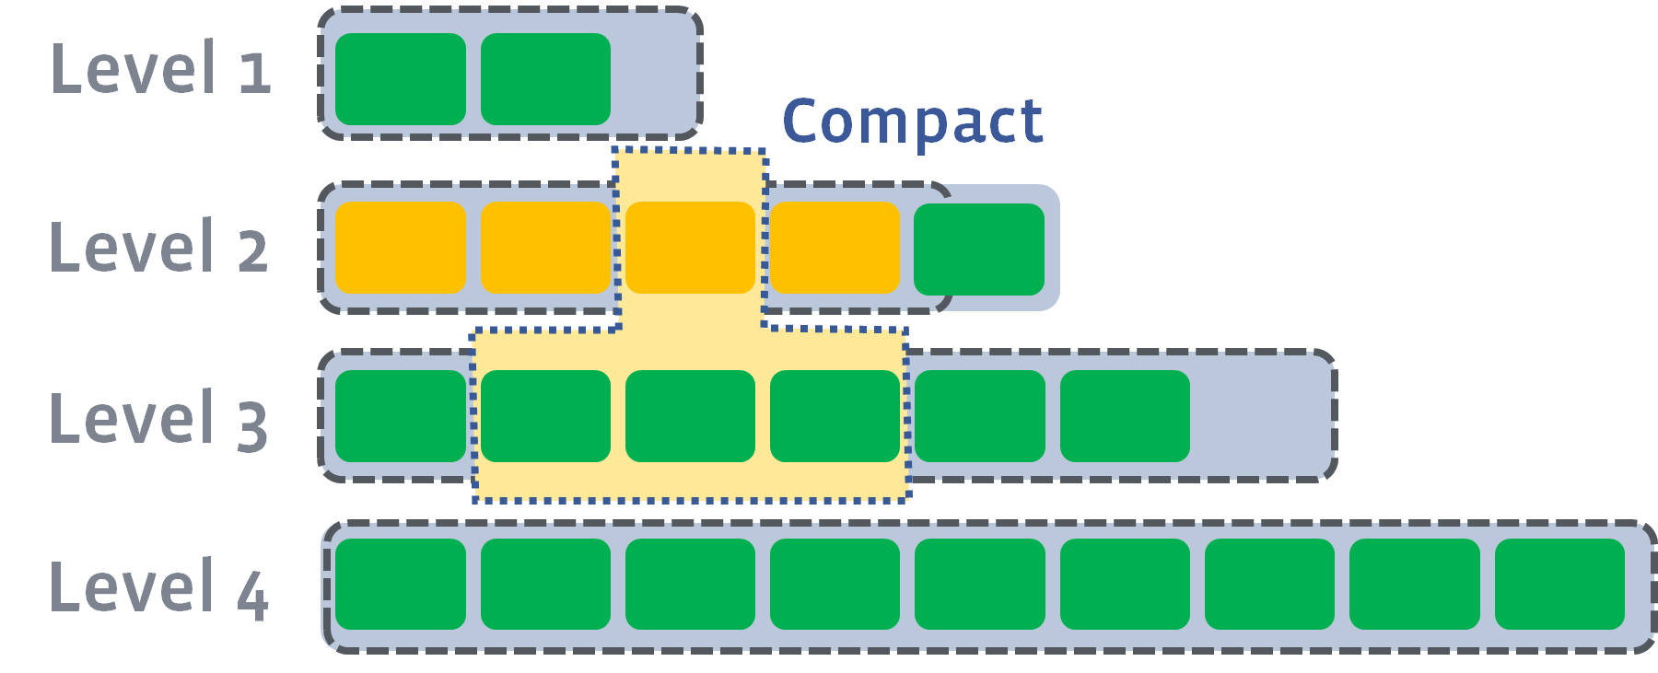
L2 + L3 → L3
L0, Key ranges of files have intersection，L0 + L1 → L1 Compact including all files on L0 and L1
L1 ~ Ln，Key ranges of files have no intersection
L0 & L1 Compactions are running on DB(frontend) node
L2 ~ Ln compactions are running on compaction worker cluster(backend)

Slide 19
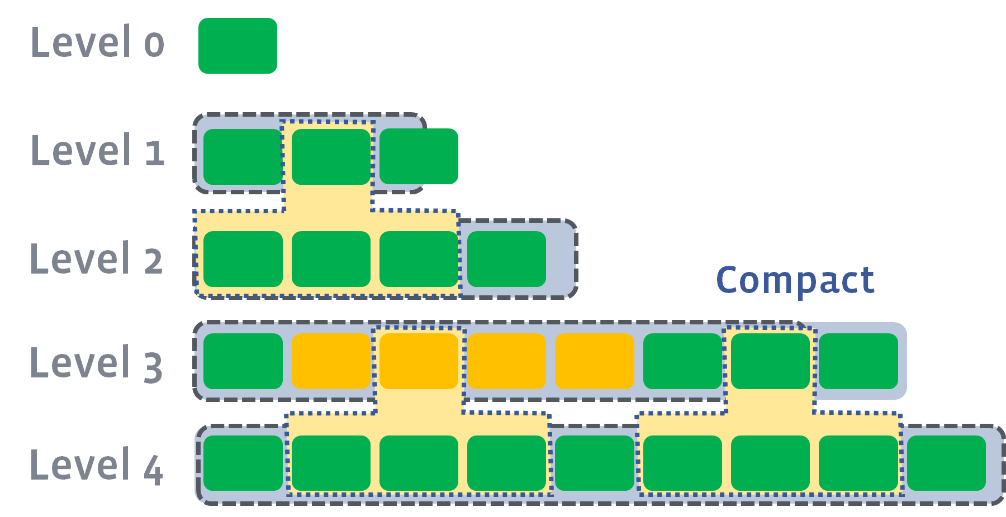
Multi Compactions run parallel
By using compaction worker cluster, CPU is not a bottle neck, parallelization can be maximized
Storage band with is expensive
More compression, less bandwidth
L0, Key ranges of files have intersection，L0 + L1 → L1 Compact including all files on L0 and L1
L1 ~ Ln，Key ranges of files have no intersection
L0 & L1 Compactions are running on DB(frontend) node
L2 ~ Ln compactions are running on compaction worker cluster(backend)

Slide 20
Distributed Compaction
All CPU quota
Compaction use 80% of CPU quota
Limit CPU utilization 30%
On data writing, compaction CPU usage is 80%, even more than 90%
CPU load is limited(EX: < 30%) to ensure query latency
Compaction CPU is accounted in 30%
Compaction is background task, not in query path
Offloading compaction to dedicated elastic computation cluster
Using idle computation resources, cheaper
EX: AWS Hot Spot Instance
Sharing compaction cluster by multiple DB service instances
Dedicated compaction node,
CPU utilization is up to 90%

Slide 21
Maximize Parallelization by Distributed compaction
L0 → L1 and L1 → L2 can not be paralleled
L0 → L1 must be fast: otherwise L0 will be flooded
L1 → L2 must be fast: otherwise L0 can not compact to L1
Increase parallelization: let L0 SST size be much larger than L1
L0→L1：Single compaction, increasing threads(subcompact)
SST Random Sampling Keys: make subcompact size more evenly
L1→L2：Multiple compactions, increasing number of compactions

Slide 22
Distributed bulk data load and index building
LOAD DATA INFILE …
CREATE INEX … ON …
Populating source files
Compacting source files
Committing result files
Using Topling CSPP AutoSort SST
Using distributed compaction
Ingesting to ToplingDB storage engine
Utilizing distributed compaction
Speeding up 30x+

Slide 23
Topling searchable in memory compression algorithm(used by SST)
 | Topling Searchable Compression |  | Block Based Compression |  | Comments
Compression Ratio | Gains All | High | Mid | Can not Gain All, Needs Compromise | Block Based compression needs block cache, consumes more memory
Access Speed |  | High | Low
Reduce Cheap SSD |  | Yes | Yes |  | DRAM is much more expensive than SSD
Reduce Expensive DRAM |  | Yes | No

Slide 24
ToplingDB: Speed up data feeding
Compaction bottle necks resolved
Data feeding becomes new bottle neck
Is SkipList MemTable the fastest?
Can transaction be speed up?
Is SkipList WriteBatchWithIndex the fastest?
Can Locking be faster?
Is MemTable Flush a must?
L0 SSTs living very short
They will be compacted to L1 very soon
CSPP MemTable
CSPP WBWI
Array Based Hash Table
Omiting L0 Flush

Slide 25
MemTable: Crash Safe Parallel Patricia Trie
RocksDB MemTables
ToplingDB CSPP MemTable
SkipList was a bottle neck
Huge number of small values
EX: secondary index value is empty
Other are not full featured
Hash,CukooHash are unordered
vector is in fact not searchable
Lower RAM usage(SkipList*30%)
Single large memory chunk
Using offset instead of pointer
Single thread 8x faster than SkipList
Multi thread linear scaling
Even faster than vector MemTable
vector write needs locking
vector needs sorting on Flush SST

Slide 26
Topling CSPP(Crash Safe Parallel Patricia)
MemTable
WBWI(WriteBatchWithIndex, for txn)
Fast SST
For L0 & L1, speed first
Auto Sort SST
MyTopling Index Building
Speed up 30x+
LockFree SkipList |  | CSPP
Comparison Based | Searching | Trie
1 | 1 thread | 8
10 | 64 threads | 240(~30x)
100 | RAM usage | 30
In place update | Writing | Copy On Write
NA | Crash Safe | Yes

Slide 27
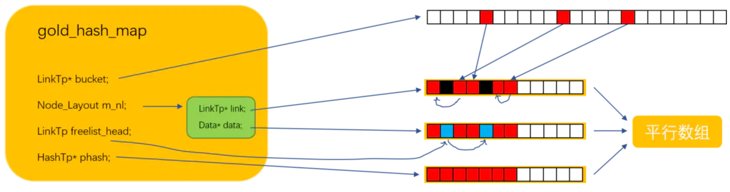
std::unordered_map
Array Based Hash Table
Locking is core of transaction
Using Hash Table heavily
Hash node needs mem alloc
mem alloc/free boring CPU
fragments Killing CPU Cache
Typical Hash Key types
Integer
string
Using array index instead of ptr
Large mem chunk, compacted
gold_hash_map
hash_strmap: string specialization
parallel
arrays
Optional Hash Cache
strpool, strlen[i] = offset[i+1] – offset[i]

Slide 28
2-Dimentional Lock Partitioning: Reducing lock contentions
RocksDB Partitioning
MyTopling Partitioning
part_idx = hash(key) % num
Any table hash into any part
When 1 thread per table, lock contentions are heavy
t1
t5,t8
t2,t4
t7
t6,t3
Same table hash into same row
Partition to columns in one row
When 1 thread per table, lock contentions and CPU Cache are light

Slide 29
Omiting L0 Flush
MemTable Flush(run background) to L0 SST is very fast
Producing CPU & IO spike, impacting query(run foreground) latency
L0 SST is Compacted to L1 very soon, lifetime is very short
Data in MemTable has copy in WAL log
Data in WAL Log is hot, lying in PageCache memory
Once Flushed to L0, data in L0 SST(PageCache) is another copy
MemTable just act as index(storing offsets to WAL Log)
Data has just one copy(in WAL Log & its PageCache)
WAL Log + MemTable act as a virtual SST, compact to L1 directly

Slide 30
THANKS
Questions

